Slide 1
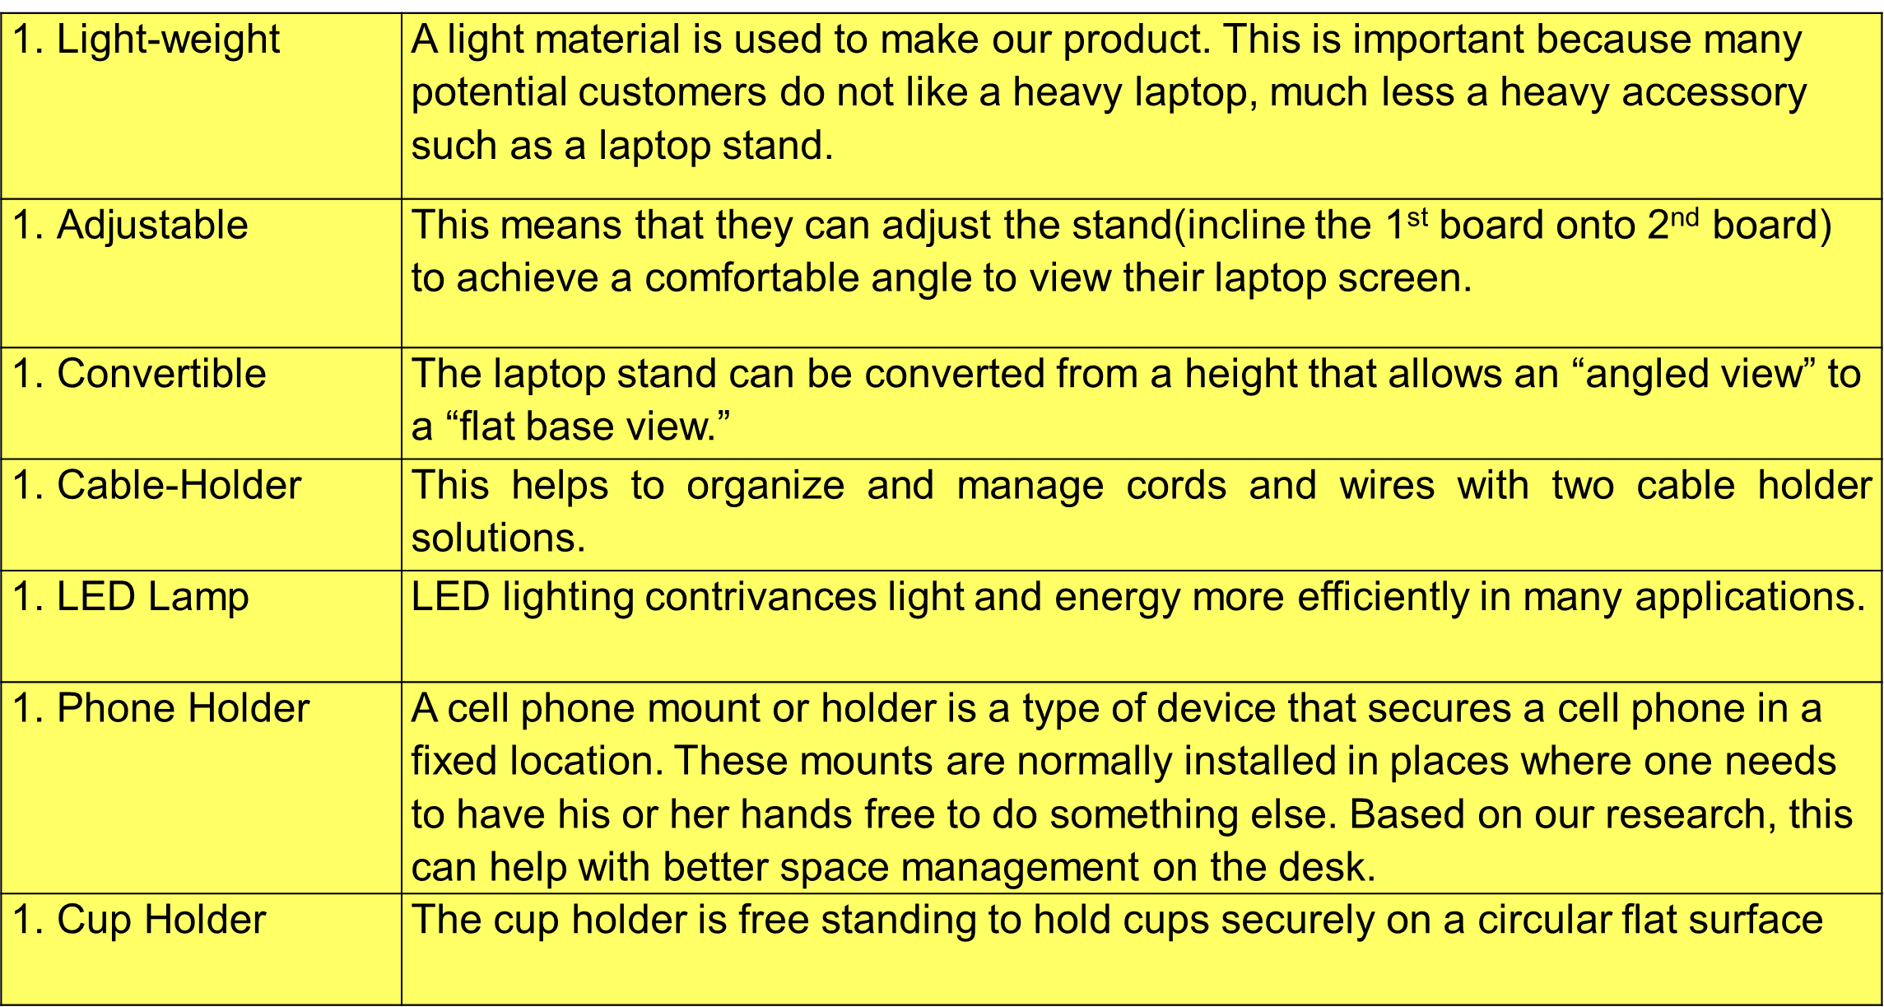

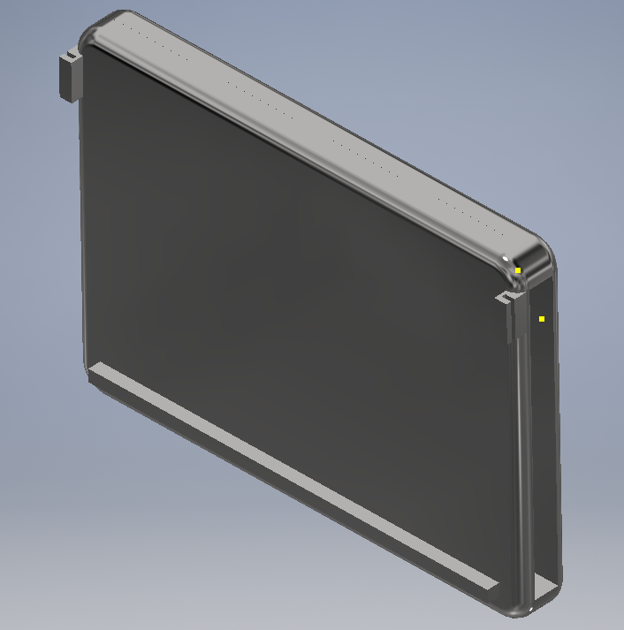
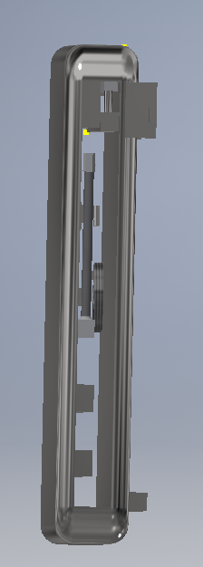
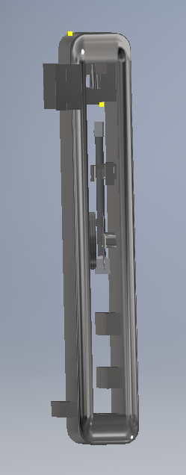
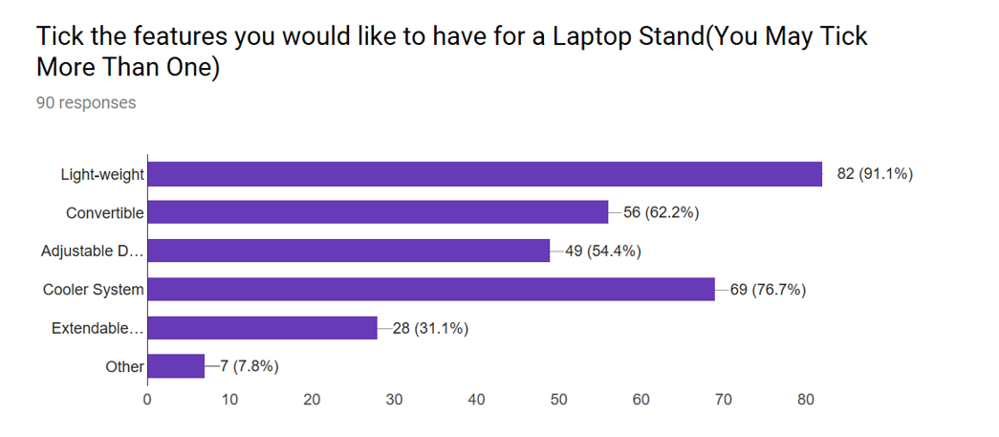
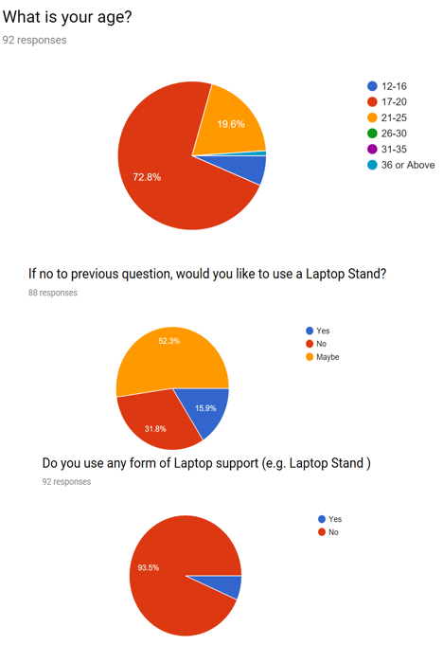
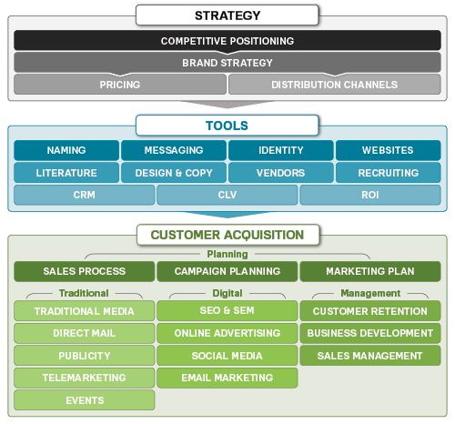
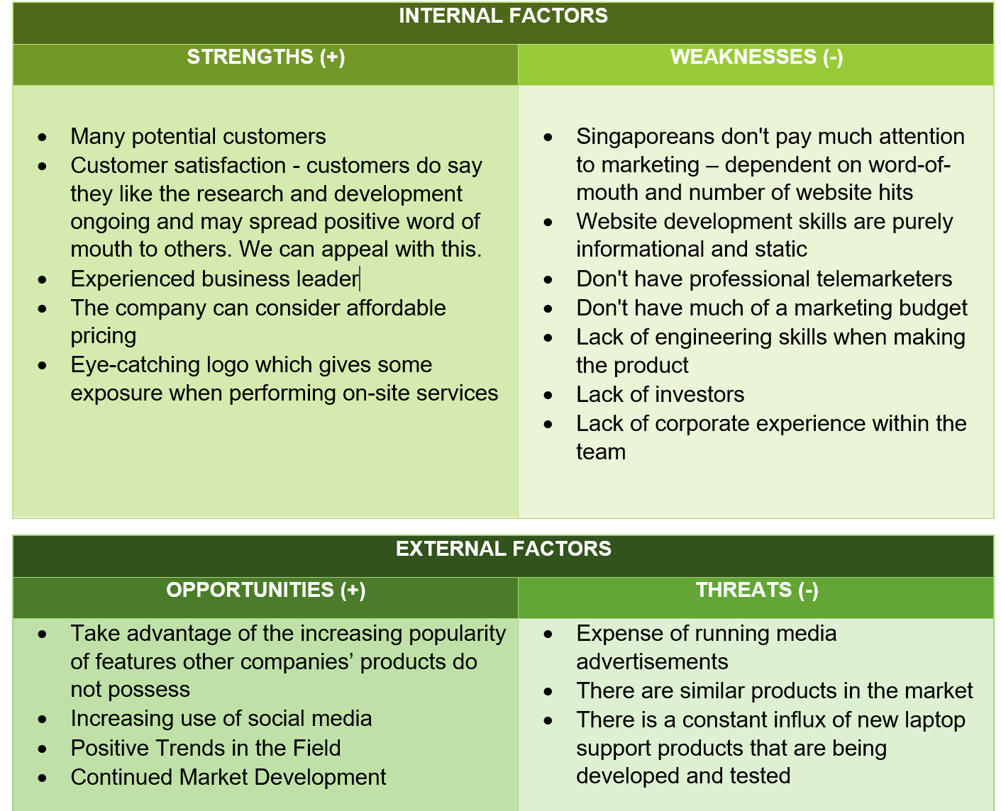
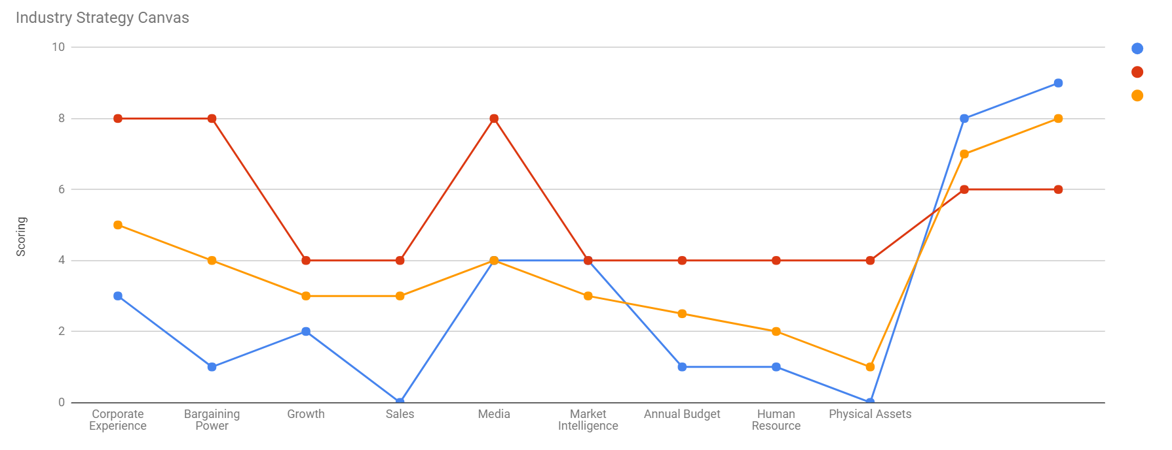
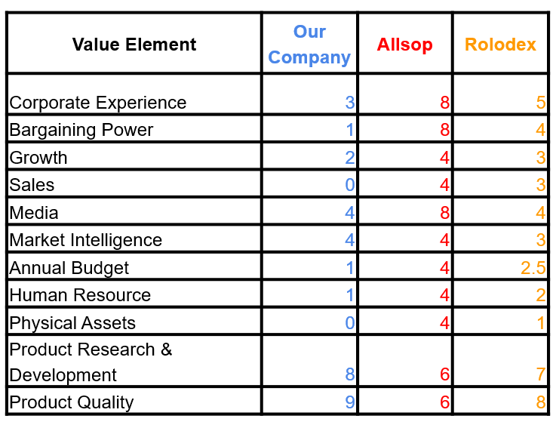

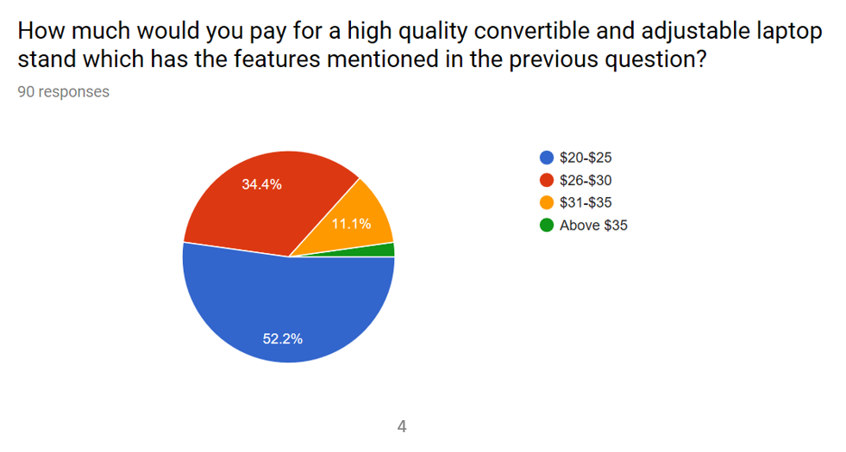
E112 2017
Tuesday(W15A)
Team 4
Objective
-To create a laptop stand which brings comfort and convenience to allow better space management
-To capitalise using features which other companies may not possess
SECTION 1
Design
-Ease of better space management with the use of multiple applications
-Other important features include the prototype being Light-weight.
SECTION 2
Target Market
Profile for Each Group:
Ø Students
Age Range: 16-25 years old
Gender: Both
Targeted Aspects:
Laptop stands are highly portable and allow you to use your computer in an inclined view almost anywhere.
If you are a student, a laptop stand will be much easier to transport from home to school and back again.
Laptop stands take up less room on a desk or table and can be put away when not in use. This is because the purpose of the laptop stand is to allow better space management.
Ø Young Adults
Age Range: 21-25 years old(Or Older)
Gender: High Percentage is expected to be male
Targeted Aspects:
Our Laptop Stand has more features as compared other similar products.
Our Laptop Stand is generally less expensive overall and offer a better overall value.
Our Laptop Stand provides a more comfortable and a much easier use. It should be noted that an aftermarket large, comfortable mouse and mouse pad are also possible with a laptop stand.
Laptop Stands have a lower risk of theft, which means less chance of losing it.
Positioning
SECTION 3
Market Strategy
High-level conceptualization of go-to-market strategy
Tools
The collateral, assets, software and processes to use during tactical execution
Customer Acquisition
The marketing mediums and tactics used to achieve strategic and revenue goals
Promotion
Social Media Advertising
Price
20-$25

